Slide 1
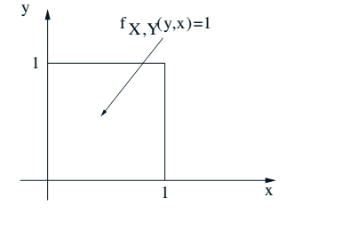
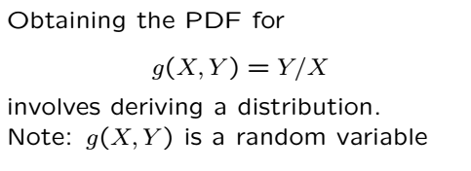
Derived RVs
PMF or PDF of a function of one or more RVs
Some texts categorize in terms of
How many RVs involved
Continuous vs discrete
Example below is for two RVs, continuous

Slide 2
Derived RVs
Do not need to find the distribution to compute
Expectations
Variances
Moments etc.

Slide 3
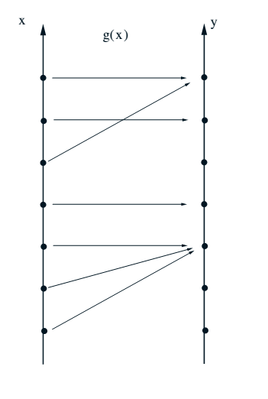

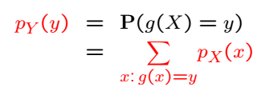
Discrete Case: One RV

Slide 4


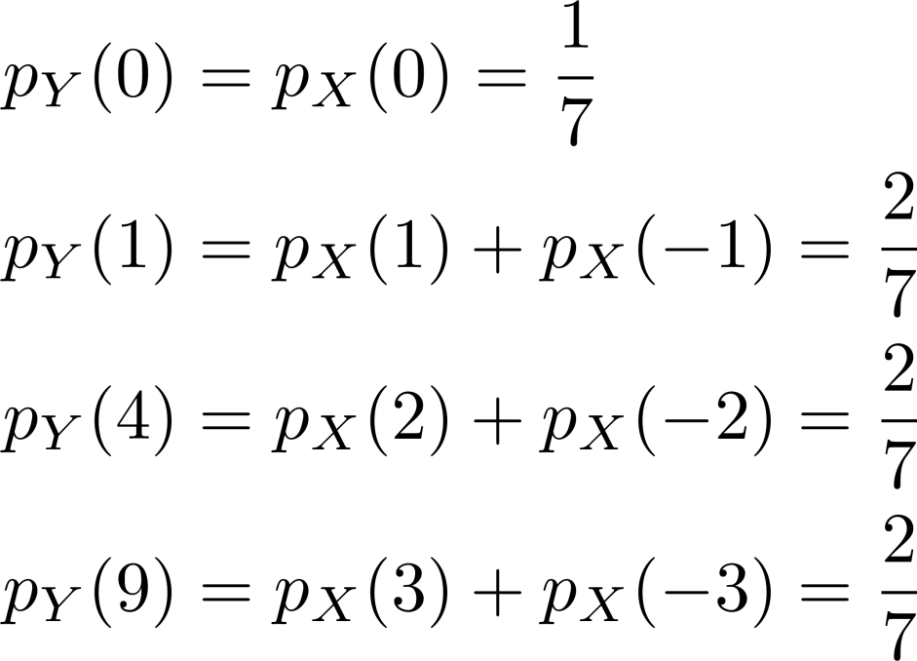
Discrete Case: One RV(Example)

Slide 5



Discrete Case: Two RVs
Similar to the single RV case:
Functions of more than 2 RV case can be similarly obtained
Notes:
6.1

Slide 6
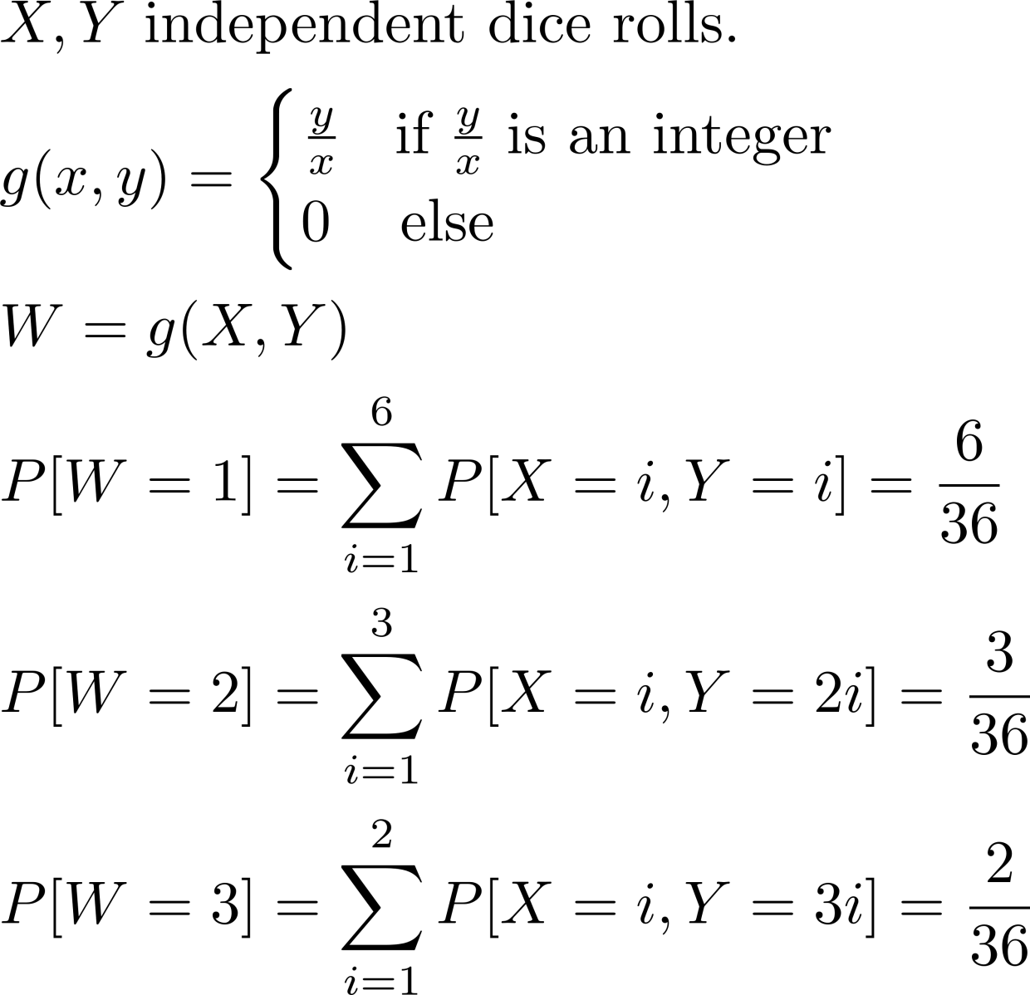
Discrete Case: Two RVs(Example)

Slide 7
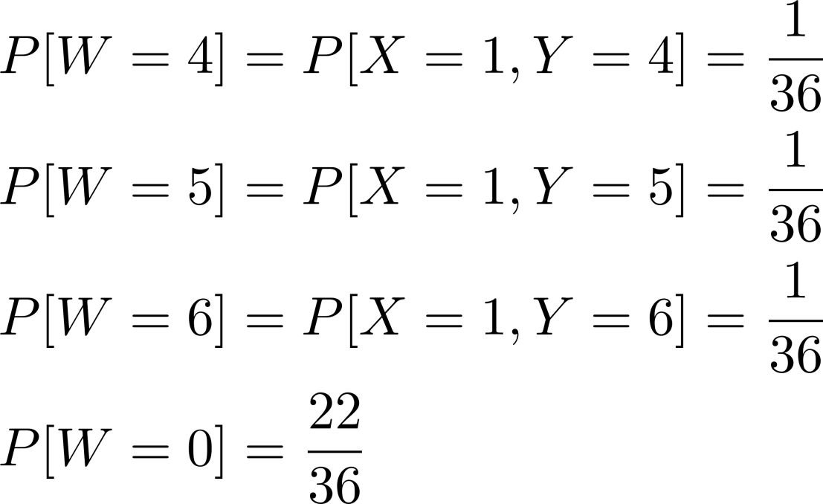
Discrete Case: Two RVs (Example) Cont’

Slide 8
Acknowledgements and Citations
Parts of these slides are adapted from the following resources:
Power Point Lecture Slides for the Textbook http://bcs.wiley.com/hebcs/Books?action=index&bcsId=8676&itemId=1118324560
John Tsitsiklis. 6.041 Probabilistic Systems Analysis and Applied Probability, Fall 2010. (Massachusetts Institute of Technology: MIT OpenCourseWare),http://ocw.mit.edu (Accessed 13 Apr, 2015). License: Creative Commons BY-NC-SA

